Slide 1
How to query your marks by App “M南医”
the Office of Teaching Affairs
July, 2015

Slide 2
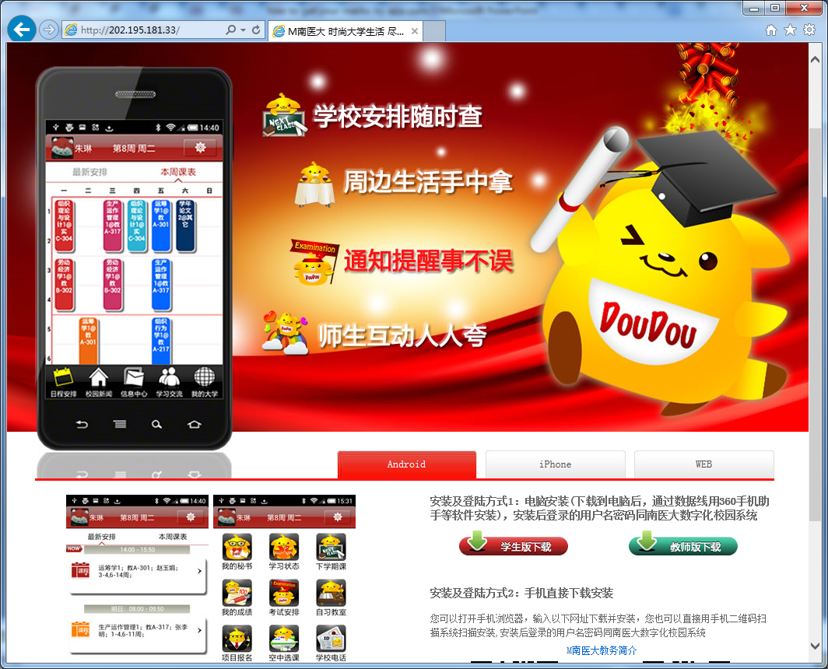
STEP 1
Visit the web page to get the app “M南医” as fellows:
http://202.195.181.33/

Slide 3
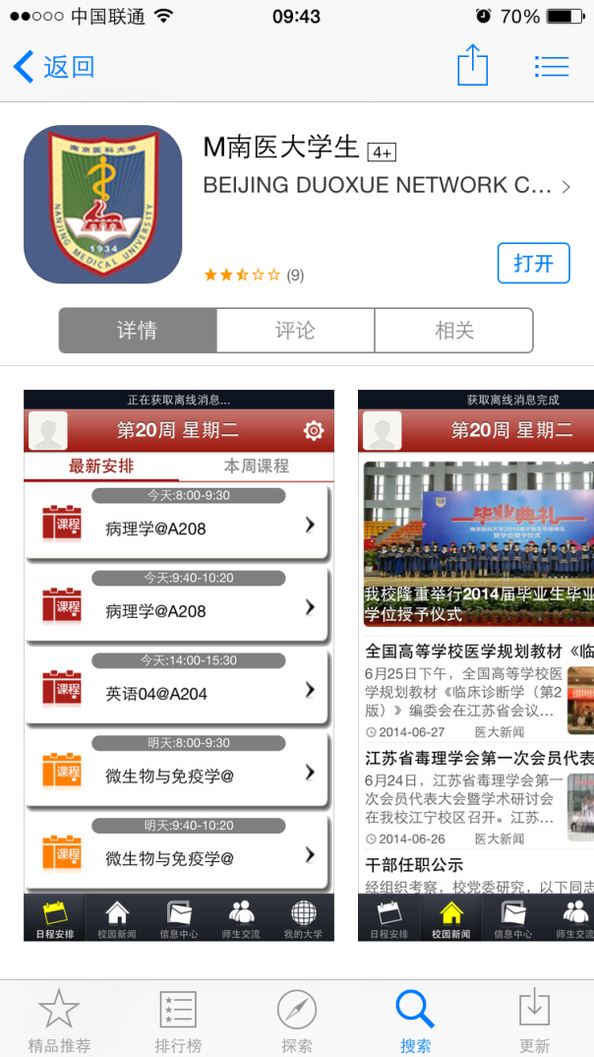
STEP 2
IOS: serch “m南医大学生” in apple app store .

Slide 4
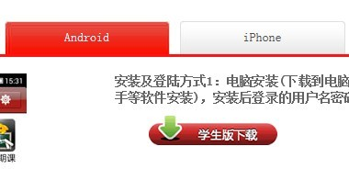
STEP 2
Andriod : click the red button “学生版下载” to get the apk of this app.
Or scan QR code on the bottom to get the app.

Slide 5
STEP 3
Open the app, the username and password is as same as Digital Campus.
If you want change your password, you must login in Digital Campus to change it .

Slide 6
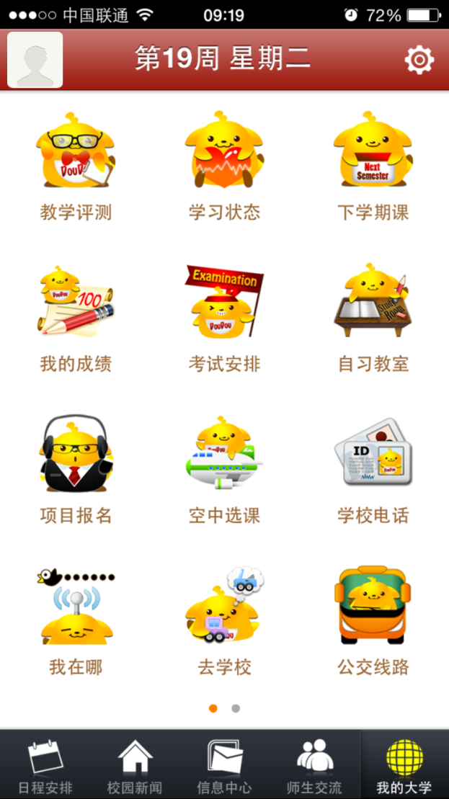
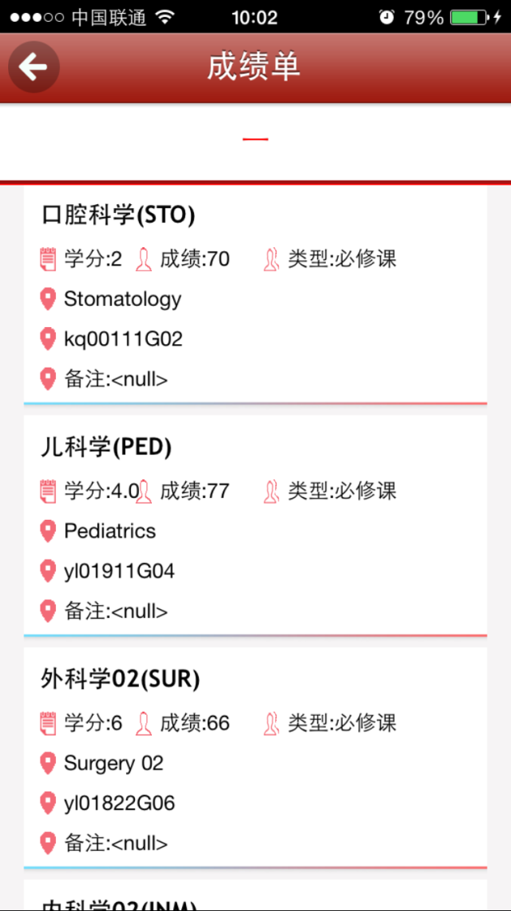
STEP 4
Click the last button “我的大学” on the buttom.
Click the second button “我的成绩” on the left.
2.
1
1.

