Slide 1
How to Assess Teachers by App “M南医”
Office of Teaching Affairs
November , 2015

Slide 2
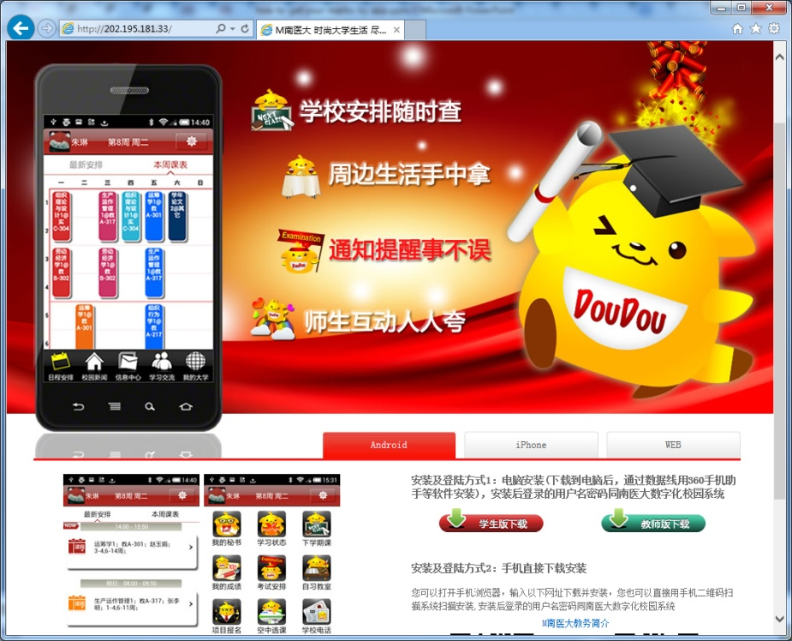
STEP 1
Visit the web page to get the newest app “M南医” (1.04 vision )as follows:
http://202.195.181.33/

Slide 3
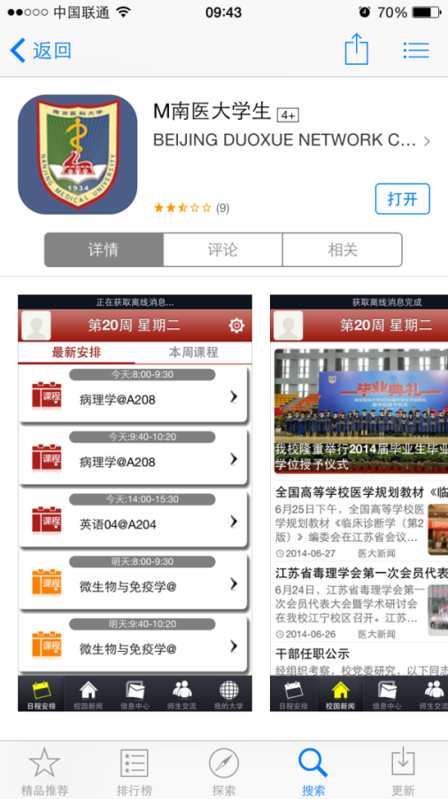
STEP 2
iOS: search for “M南医大学生” in the Apple App Store.

Slide 4
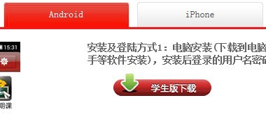
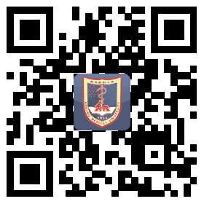
STEP 2
Android : click the red button “学生版下载” to get the apk of this app.
Or scan the QR code on the bottom to get the app.

Slide 5
STEP 3
Open the app: the username and password is the same as E-learning system.
If you want to change your password, you must login into the E-learning system to change it .

Slide 6
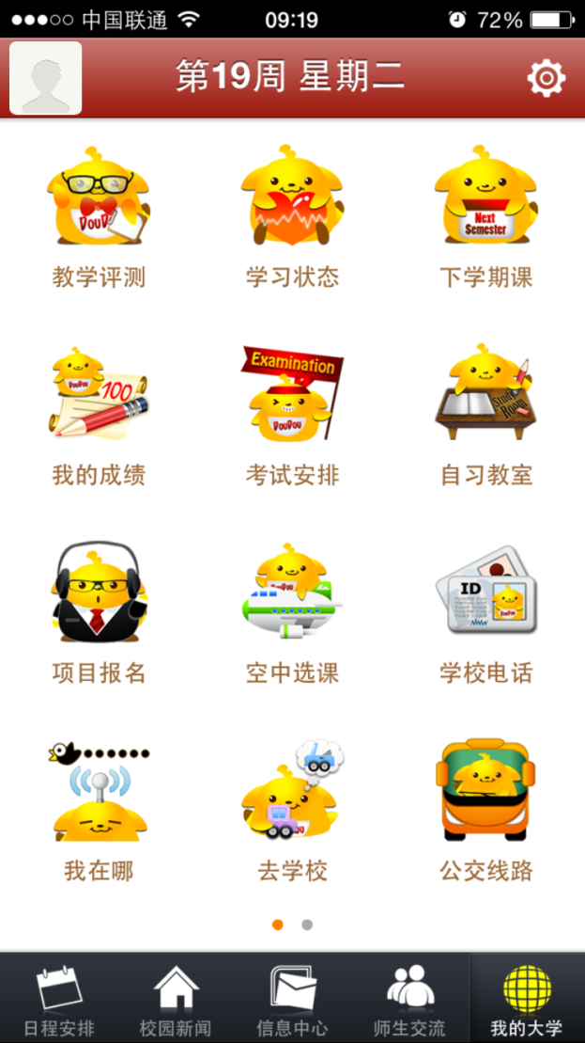
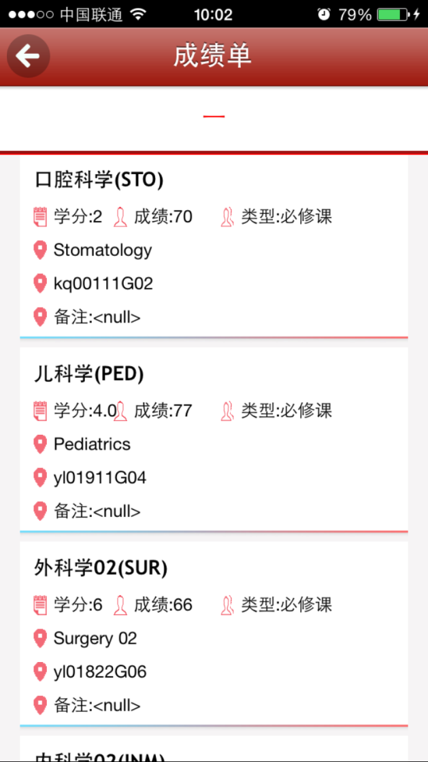
STEP 4
Click the button on the very bottom-right corner: “我的大学”.
Click the button “教学测评” according to the picture on the left.
.
1
1.

Slide 7
STEP 5
“待测评教师” means the teachers who need to be assessed by you at current semester.
“已测评教师” means the teachers who have been assessed by you.
Click the button “待测评教师”

Slide 8
STEP 6
Click the button “待测评教师”
Choose the course showed in the app.

Slide 9
STEP 7
Choose the teacher who had finished his or her own teaching task .

Slide 10
STEP 8
Click the icon on the top-right corner, the language of the page will change to English.
There are 5 items needing your selection, you also can write something in “other suggestions ”.
At last, please click the “submit” button to finish the assessment.

Slide 11
Your opinion is very important for us to improve our teachers' performance .
Please assess every teacher who taught you.
The exam result will not be shown before you finish all teachers ’ assessment.

